Slide 1



HR Analytics Case Study

Slide 2
Problem Statement

Slide 3
Problem Statement
People Charm’, a growing company is facing a high attrition rate among their employees which in turn affects their business due to lack of expertise and experience.
Their HR department is assigned the task to reduce the attrition rate by retaining employees who are about to churn out.
They need to recommend special plans or strategies which will help them to retain their employees which in turn will help them to grow bigger as a company

Slide 4
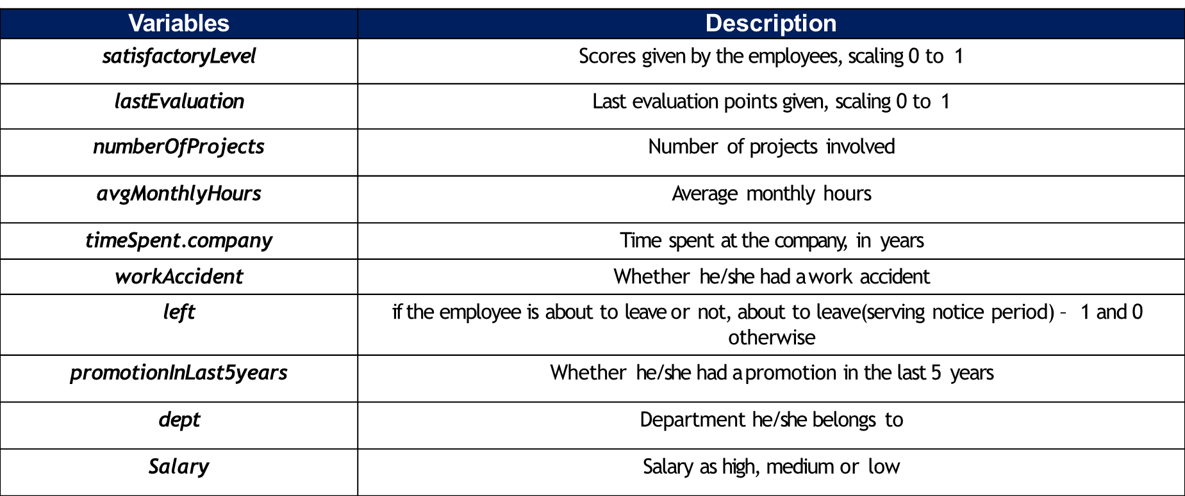
Variable Description
Total size :14999 x 10
Data file : People Charm case.csv

Slide 5
Thank You!

